Slide 1
Basic Linux commands
Oleksandr Krynytskyi

Slide 2
Before we begin...
Oleksandr Krynytskyi

Slide 3
User-friendly
Desktop Environments
Oleksandr Krynytskyi

Slide 4
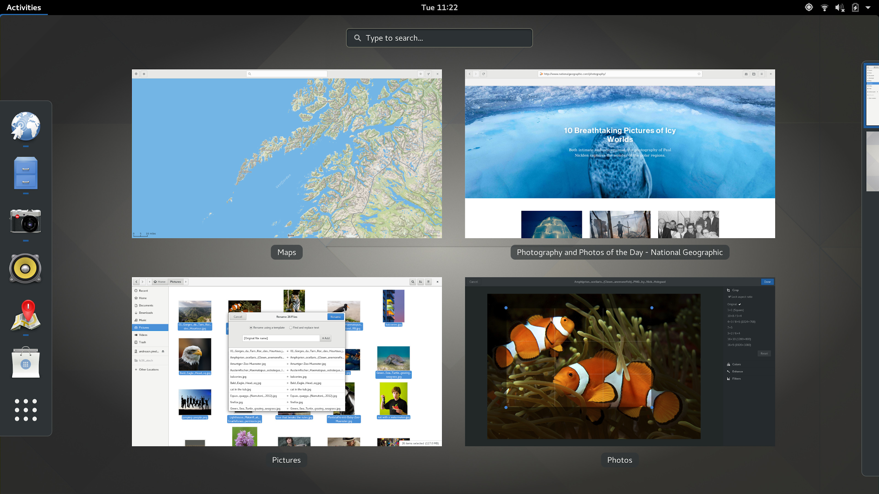

GNOME Shell

Slide 5
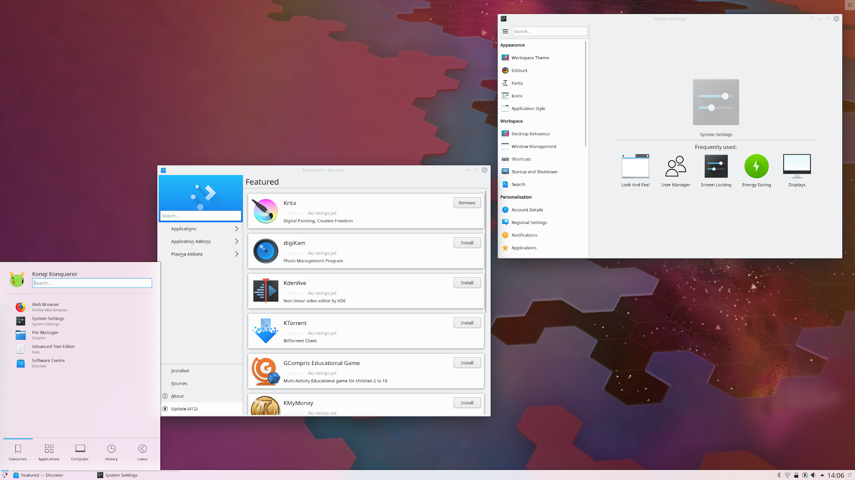

2. KDE Plasma

Slide 6
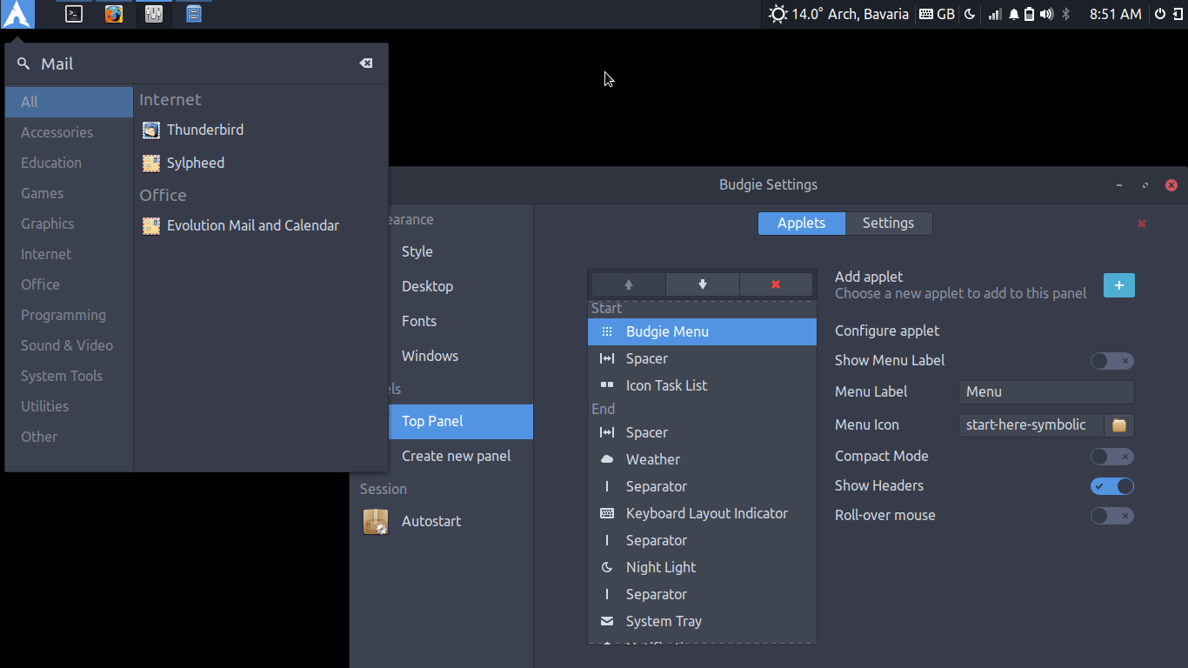

3. Budgie Desktop

Slide 7
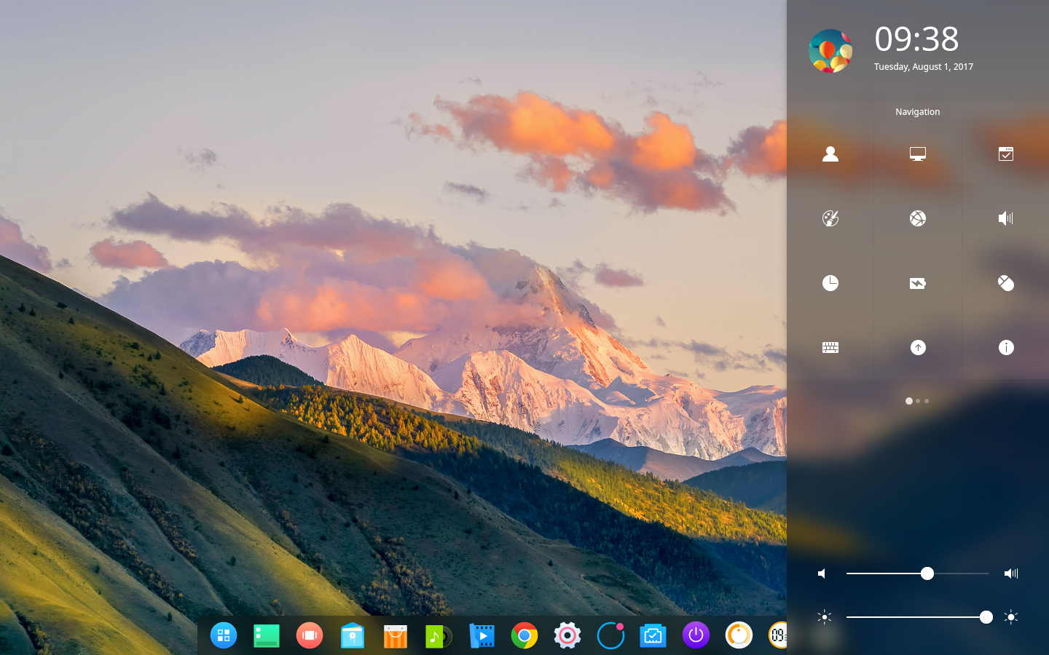

4. Deepin Desktop Environment

Slide 8
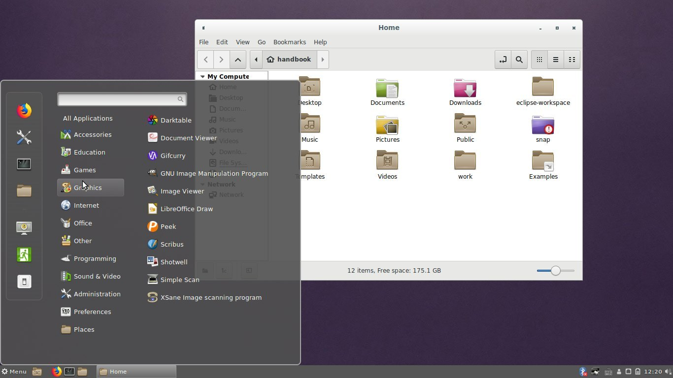

5. Cinnamon Desktop

Slide 9
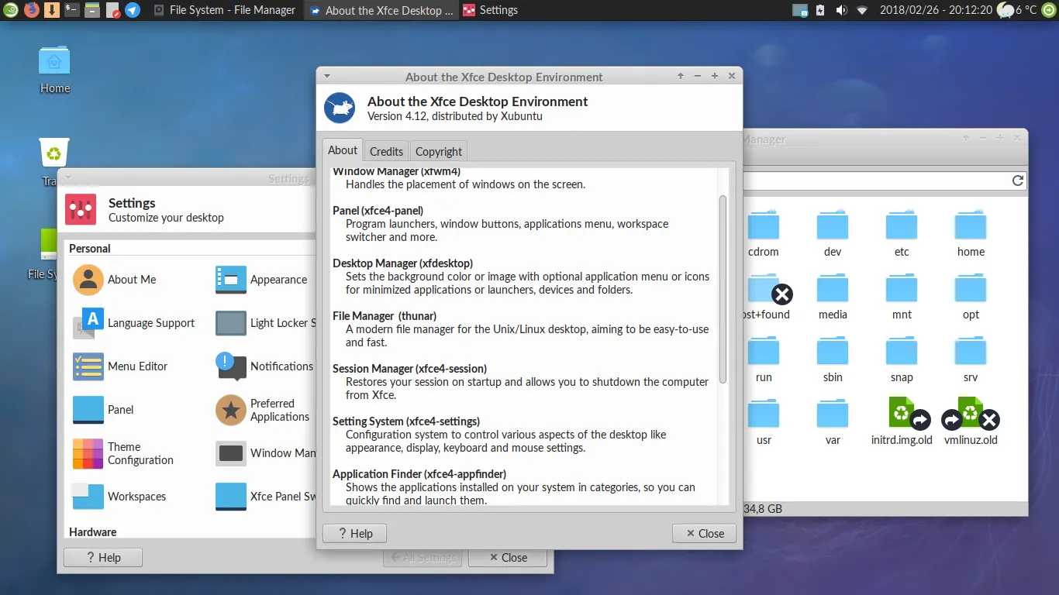

6. XFCE

Slide 10
User-friendly
Linux distributions
Oleksandr Krynytskyi

Slide 11
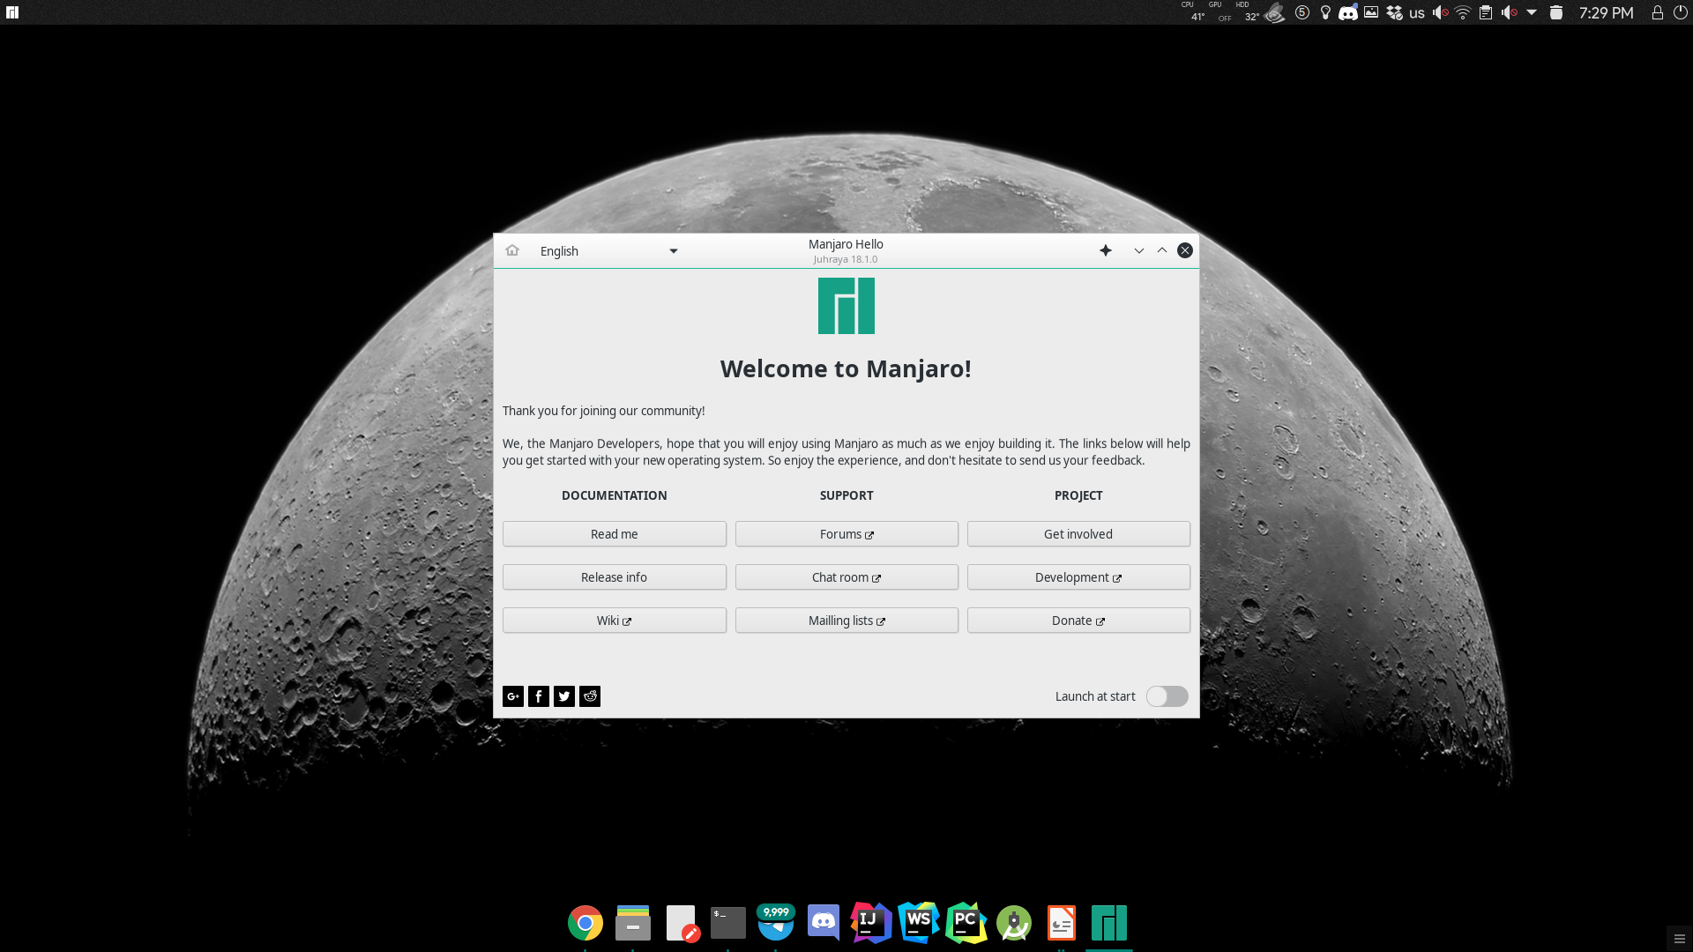

1. Manjaro KDE 18.1 (Juhraya)

Slide 12
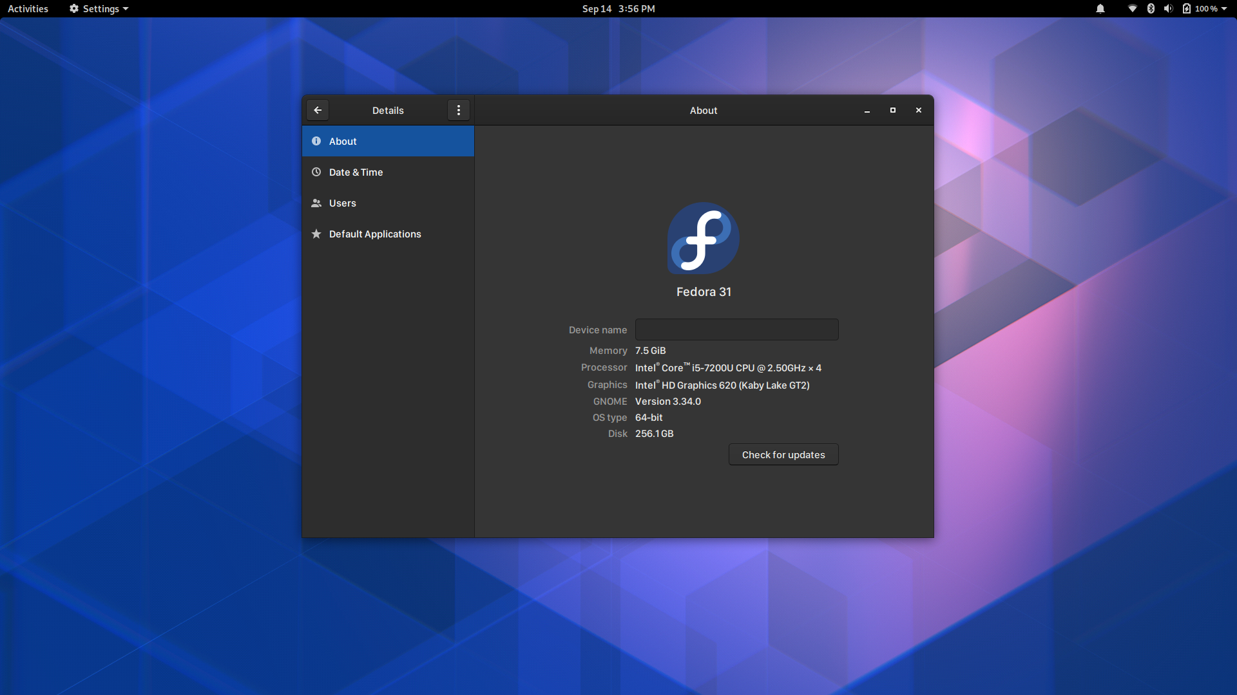

2. Fedora 31

Slide 13
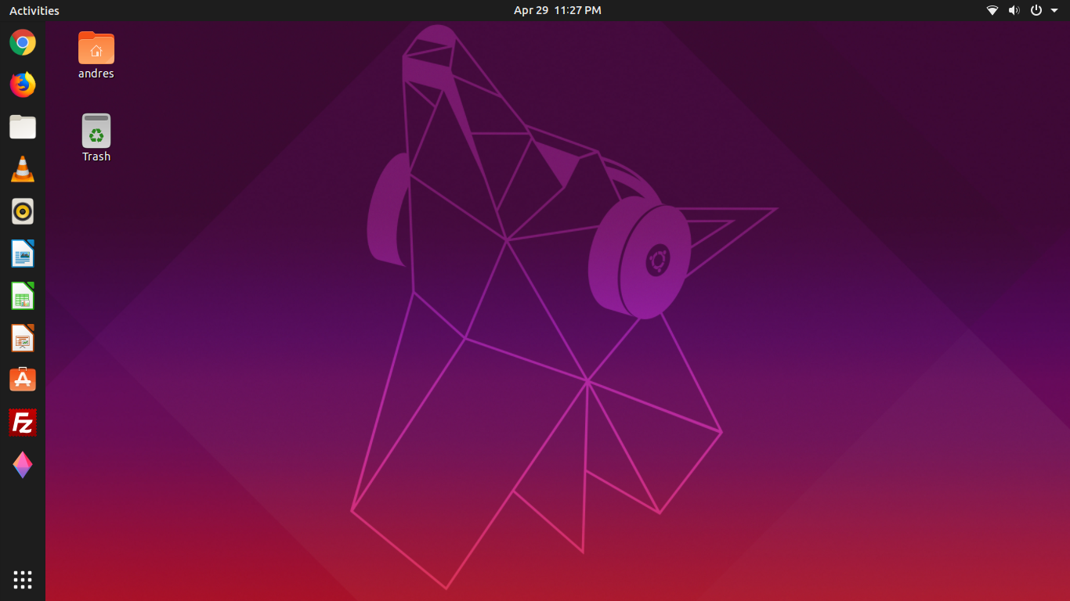

3. Ubuntu 19.04 (Disco Dingo)

Slide 14
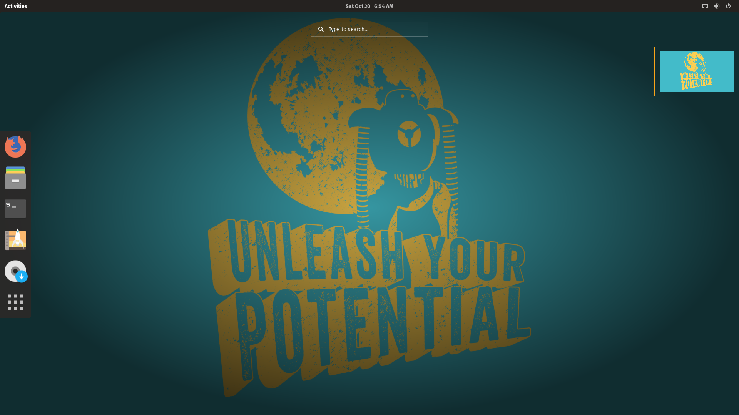

4. Pop!_OS 19.04

Slide 15
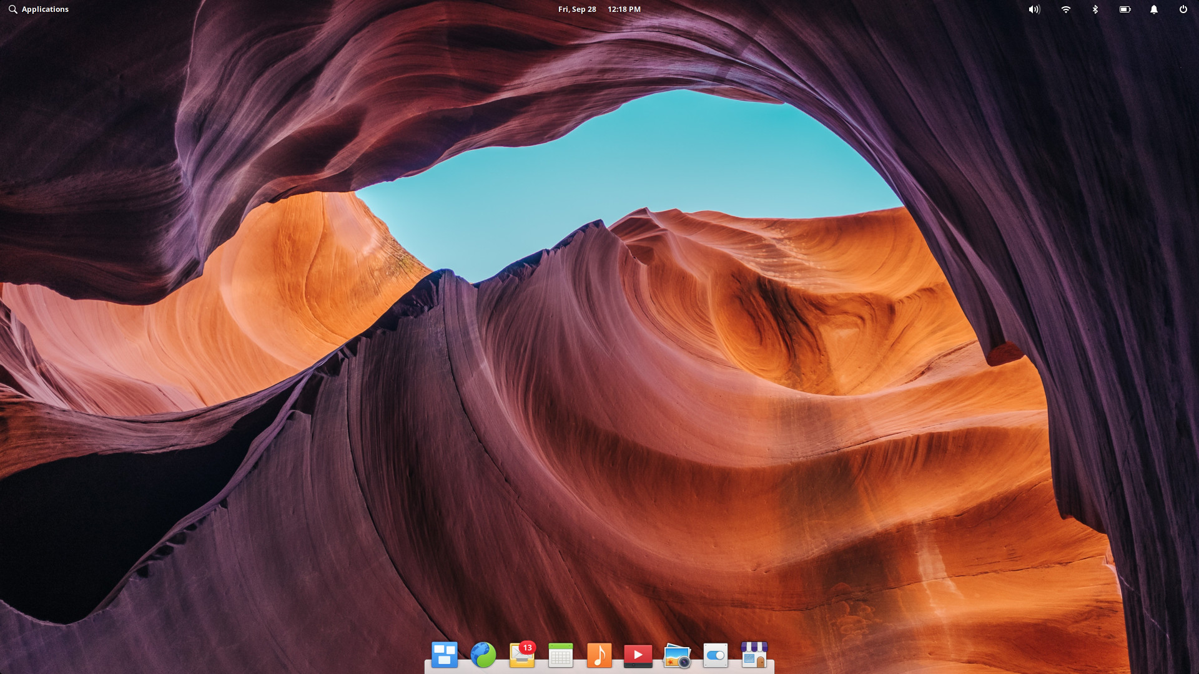

5. Elementary OS 5.0 (Juno)

Slide 16
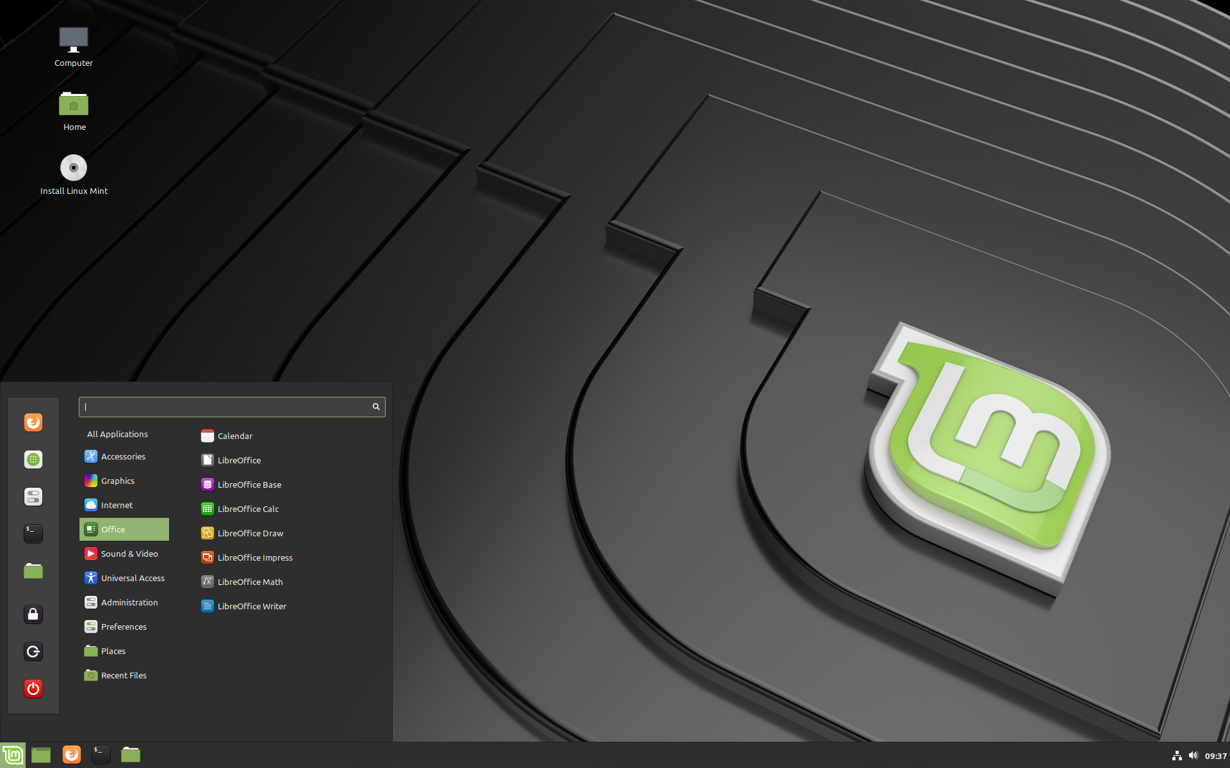

6. Linux Mint 19.2 Cinnamon (Tina)

Slide 17
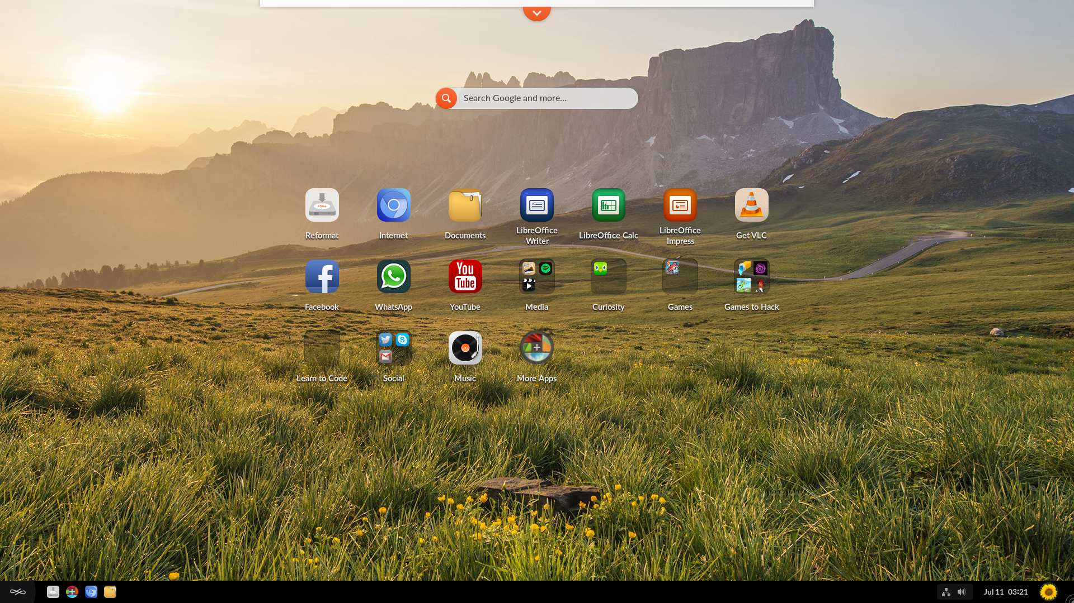

7. Endless OS 3.6

Slide 18
What is Linux?
Oleksandr Krynytskyi

Slide 19
What’s Linux?
Linux is a family of open source Unix-like operating systems based on the Linux kernel, an operating system kernel first released on September 17, 1991, by Linus Torvalds. Linux is typically packaged in a Linux distribution.
Oleksandr Krynytskyi

Slide 20
Linux isn’t like Windows or Mac OS X. Microsoft combines all the bits of Windows internally to produce each new release of Windows and distributes it as a single package. If you want Windows, you’ll need to choose one of the versions Microsoft is offering.
Linux works differently. The Linux operating system isn’t produced by a single organization. Different organizations and people work on different parts. There’s the Linux kernel (the core of the operating system), the GNU shell utilities (the terminal interface and many of the commands you use), the X server (which produces a graphical desktop), the desktop environment (which runs on the X server to provide a graphical desktop), and more. System services, graphical programs, terminal commands – many are developed independently from another. They’re all open-source software distributed in source code form.
Oleksandr Krynytskyi
Notes:
!!! Tell about “parent” distributives (*-based)

Slide 21
File system
Oleksandr Krynytskyi
Notes:
All users, including the root superuser, have their own home directories where their personal data is stored, for example: documents, bookmarks or letters. System directories containing the main configuration files can only be changed by the superuser.
On Linux, all files and directories are placed in a tree structure. The topmost directory of the file system is referred to as root (root) or simply / (not to be confused with the root user). A possible analogue of / in the Windows operating system would be C: \. All other directories in Linux are accessible from the root and organized in a hierarchical structure.
Case-sensitive
Unlike Windows, files on Linux may have extensions, such as .txt, but do not need them. When you start working with the command line, this feature sometimes makes it difficult for beginners to distinguish files from directories, depending on the command you use to list the directories or files.
Hidden files
Like Windows, Linux also distinguishes between “regular” files and hidden files, which are often configuration files and therefore undesirable to make them visible or accessible to the average user. On Linux, hidden files are marked with a dot before the name (for example, .hiddenfile).
/
The root directory is the starting point of the directory tree (file system).
/bin
Important binary (binary) files, such as commands that are necessary for both the system administrator and ordinary users. Usually also contain command interpreters such as Bash.
/boot
Bootloader files.
/dev
Files needed to access computer devices.
/etc
System configuration files.
/home
Contains home directories of all users who have accounts in the system. Only the root user home directory is not located in home, but in /root.
/lib
Important dynamic libraries (shared libraries) and kernel modules.
/media
Mount points for removable media.
/mnt
Mount point for temporary mounting of file systems.
/opt
Additional software packages.
/root
The root superuser home directory.
/sbin
Important system binaries.
/srv
Data for the services provided by the system.
/tmp
Temporary files.
/usr
Secondary hierarchy with read-only data.
/var
Variable data such as log files

Slide 22
Basic commands
Oleksandr Krynytskyi
Notes:
pwd
ls
cd
mkdir & rmdir
rm
touch
man & --help
Htop
Ip
Kill
killall
cp
mv
echo
Cat
nano, vim
sudo
tar
uname
apt
pacman
ping && traceroute
Ps
diff -y -W 70 alpha1.txt alpha2.txt --suppress-common-lines
less
grep
curl

Slide 23
We trust you have received the usual lecture from the local System Administrator. It usually boils down to these three things:
#1) Respect the privacy of others.
#2) Think before you type.
#3) With great power comes great responsibility.
root's password:

Slide 24
WHOEVER YOU ARE, WHATEVER YOU DO, PLEASE DON'T TRY THIS AT HOME, SCHOOL OR ANYWHERE!
$> sudo rm -rf --no-preserve-root /
Oleksandr Krynytskyi

Slide 25
THANK YOU FOR YOUR ATTENTION!
Oleksandr Krynytskyi

